Slide 1

Credit Card Fraud Detection
by Isaac Ng Sheng

Slide 2
Rationale for choosing Dataset
Personal Interest:
Background in Anti-Money Laundering / Regulatory Technology (Subset of Fintech)
Aim to pursue a career in Fintech (for the $) and thus looked for a dataset that could be beneficial
Nature of Dataset:
Rich Dataset found on Kaggle, containing 164 Attributes and 2 Large CSV Files (Application_Data and Previous_Application_Data)
Clear Goal in locating the dependent variable (being the variable `TARGET`)

Slide 3
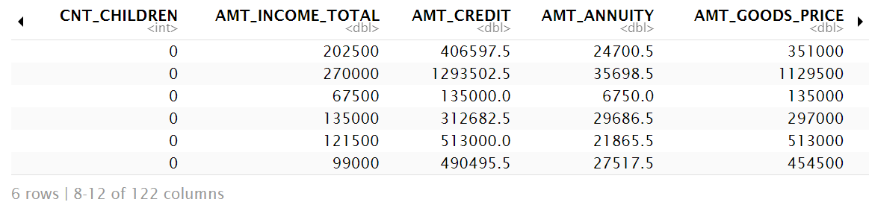
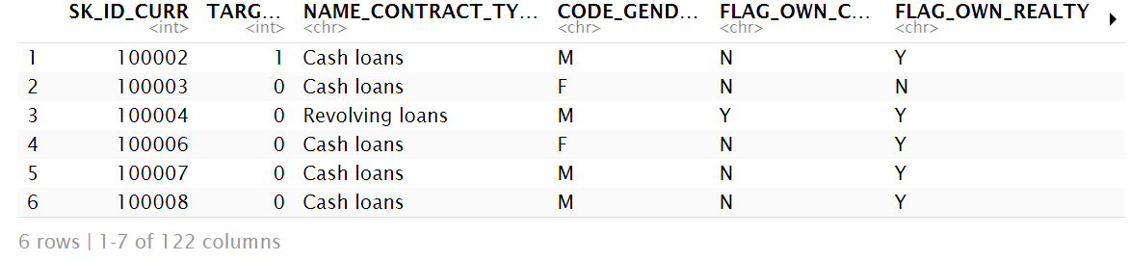
Dataset overview
Notes:
Mix of Categorical/Binary & Numeric

Slide 4
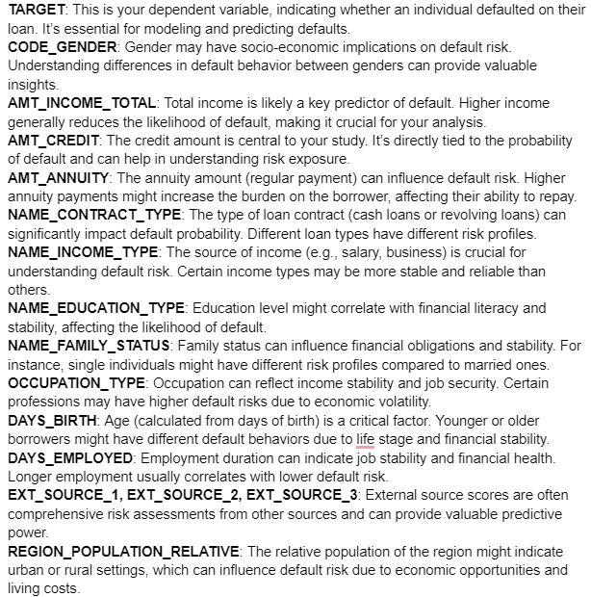
Dimensionality Reduction
Decided on zooming into specific variables that I believe would be useful in their predictability of loan defaults
Such variables reflect socio-economic factors, financial stability, and established industry practices

Slide 5
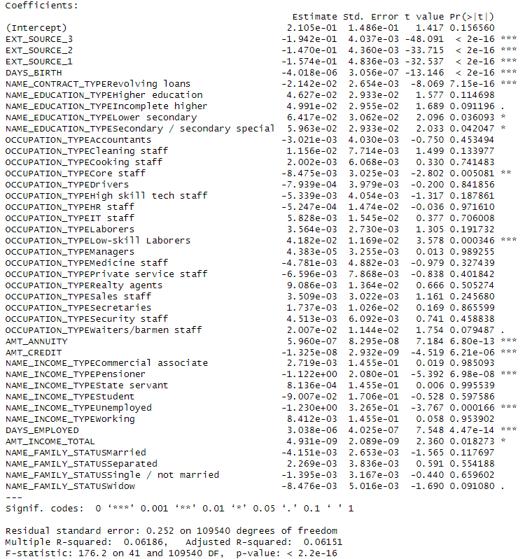
Dimensionality reduction
Reduced dimensionality further through stepwise model selection
as.factor() is required for categorical variables, resulting in some subclassifications being significant while others are not
Decided to only remove NAME_FAMILY_STATUS

Slide 6
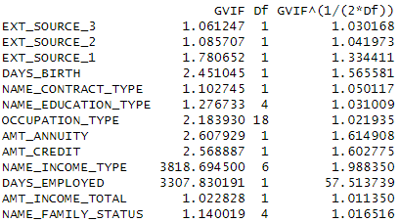
Dimensionality reduction
Reduced dimensionality further through multicollinearity checks
Removed DAYS_EMPLOYED for having high multicollinearity

Slide 7
Econometrics Model
Main Econometrics Model would be `TARGET` vs `AMT_ANNUITY`
Rationale for choosing main independent variable:
AMT_ANNUITY directly measures the amount of credit given to individuals, affecting their repay-ability and likelihood of defaulting.
AMT_ANNUITY also captures the financial commitment and risk associated with each loan, making it a critical predictor in assessing loan default probabilities
AMT_ANNUITY is chosen over AMT_CREDIT as it reflects the annual repayment burden of the loan and directly impacts the borrower’s cash flow and ability to meet annual payment obligations

Slide 8
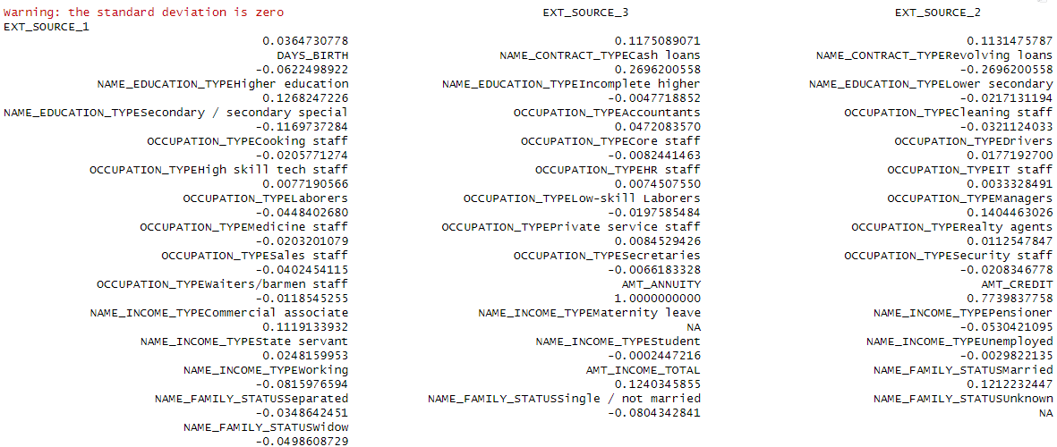
Controlling of Confounders
Observational Confounders: AMT_CREDIT
AMT_CREDIT clears the multicollinearity test and is considered to contain additional information (maintains linear independence)
Being highly-correlated while being a large contributor to the probability of the individual defaulting, AMT_CREDIT will be added into the model as a control, to isolate the effect of AMT_ANNUITY on the TARGET

Slide 9
Controlling of Confounders
Unobservable Confounders: Income Stability & Financial Behavior/Attitude
Initial belief that CNT_CHILDREN would be a suitable IV, having an impact on the probability of defaulting as more children would increase financial burden¹, leading to a higher likelihood, while being correlated to AMT_ANNUITY as individuals would have to borrow more².
This is supported:
Showcasing how having more children decreases an individual’s likelihood for getting a loan
Claiming number of children increases the monthly debt repayments
Notes:
¹Keens, Sarah, “How Having Children Can Impact Your Borrowing Capacity”, MoneyQuest, published February 1, 2022, accessed November 12, 2024, https://www.moneyquest.com.au/news/how-having-children-can-impact-your-borrowing-capacity/
²Kowalski, R., Strzelecka, A., Wałęga, A. et al. Do Children Matter to the Household Debt Burden?. J Fam Econ Iss 44, 1007–1022 (2023). https://doi.org/10.1007/s10834-023-09887-y

Slide 10
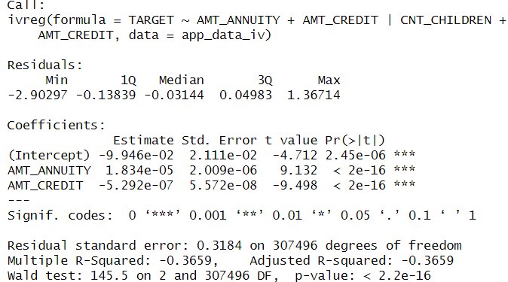
Results and F-Statistic for Weak Instrument Test
Results: All variable coefficients show high statistical significance
Weak Instrument Test: F-Statistic from first stage regression: 224477.3
F-Statistic should be > 10, normally such unusually high F-Stat is based on multicollinearity, however that has been accounted

Slide 11

Correlation test for iv
Investigation of unusually high F-Statistic led me to conducting a Correlation Test which reveals weak correlation of CNT_CHILDREN and AMT_ANNUITY: 0.02137
Granted, a weak correlation should not be the reason for the high F-Statistic, it shows that for this dataset, CNT_CHILDREN itself may not be a good IV

Slide 12
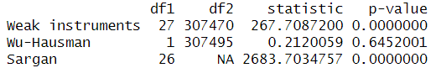
Overidentification
To combat the possibly weak CNT_CHILDREN IV, an overidentification³ is done, with the model: ivreg(TARGET ~ AMT_ANNUITY + AMT_CREDIT | CNT_CHILDREN + NAME_INCOME_TYPE + REGION_POPULATION_RELATIVE + OCCUPATION_TYPE + AMT_CREDIT, data = app_data_test)
F-Statistic from the combined first stage regression: 16641.36
Interpretation: Weak Instruments: Instruments are Strong Wu-Hausman: Endogeneity may not be a significant issue Sargan: At least one instrument is not valid
Notes:
³Angrist, Joshua D. and Krueger, Alan B. “Instrumental Variables and the Search for Identification: From Supply and Demand to Natural Experiments”, Journal of Economic Perspectives – Vol 15, No. 4, Fall 2001, Pg 69-85, https://economics.mit.edu/sites/default/files/publications/Instrumental%20Variables%20and%20the%20Search%20for%20Identifi.pdf?form=MG0AV3

Slide 13
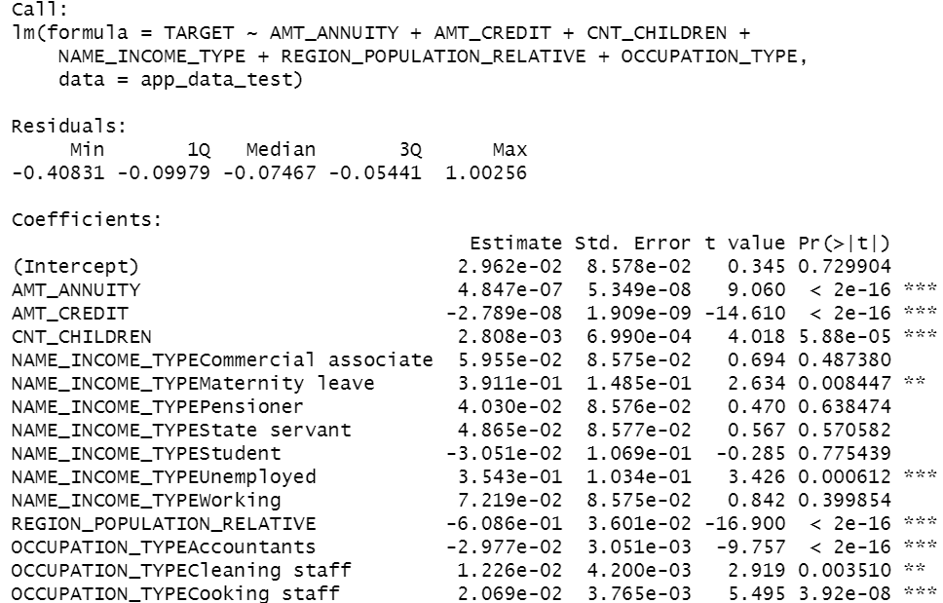
Regression inclusive of ivs
Baseline Intercept is not significant
Estimates of all other variables are small as it is a representation of probability
AMT_ANNUITY is +ve
AMT_CREDIT is –ve
CNT_CHILDREN is +ve

Slide 14
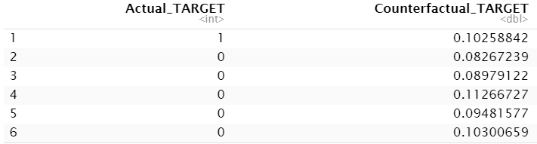
Counterfactual values
Estimating Counterfactuals if AMT_ANNUITY was doubled

Slide 15
Conclusion
Counterfactual Results show the doubling AMT_ANNUITY generally increases the probability of fraud across the observations, even for those that did not originally experience it.
This meets expectations as a significant increase in AMT_ANNUITY would lead to an increase in financial burdens and the inability to repay such loans
Observation 1 is the exception, significantly reducing their probability of fraud
Observation 1 AMT_ANNUITY: 24700.5; AMT_INCOME_TOTAL: 202500
1. Considering their AMT_INCOME_TOTAL is significantly higher than their AMT_ANNUITY, they are able to pay off the debt despite doubling the AMT_ANNUITY.
2. Doubly AMT_ANNUITY might lead to stricter financial discipline, thus lower defaulting likelihood.

Slide 16

Future considerations
Possibility of estimating counterfactuals through Sharp Regression Discontinuity
Perks:
Improving Internal Validity
Robust Counterfactual Estimates (addressing different sources of bias)
Notes:
IV corrects for endogeneity, while Sharp RDD provides a clean comparison around the cutoff.

Slide 17
Thank you

